Slide 1


COURSE BASED PROJECT
OOPS USING JAVA
Course Code – R1UC201C
T I T L E
C A B M A N A G E M E N T S Y S T E M
Sem-II (Session – 2024-25)
TEAM MEMBER
ANKIT KUMAR SINGH
AYUSH RAJ
KRISHIKA KUMARI
TUSHAR VARMA

Slide 2
CAB Management System: Project Review Index
Review 1: (Slides 3-22)
Project Initialization, Database Setup, User Management Templates and Validation.
Review 2: (Slides 23-34)
Implementataion of Core Features and Project Documentation

Slide 3

INTRODUCTION
Java-based desktop application for cab booking
Built using Swing GUI and MySQL database
Allows user registration, login, and cab booking
Supports payment processing and booking history
Simple, user-friendly interface for easy navigation

Slide 4

PROBLEM STATEMENT
Manual Operations Are Inefficient
Traditional cab booking methods (calls or manual logs) are time-consuming and prone to human error.
Customer Inconvenience
Lack of instant booking, availability info, or booking history leads to poor customer experience and delays.
Driver & Admin Challenges
Managing bookings, schedules, and customer data manually can cause confusion, double bookings, and data mismanagement.
Need for Automation
A digital Cab Management System is required to automate booking, tracking, and payment processes for speed and accuracy.
Benefits of Digital Solution
Enhances user experience, improves booking efficiency, ensures secure payments, and reduces human error.

Slide 5
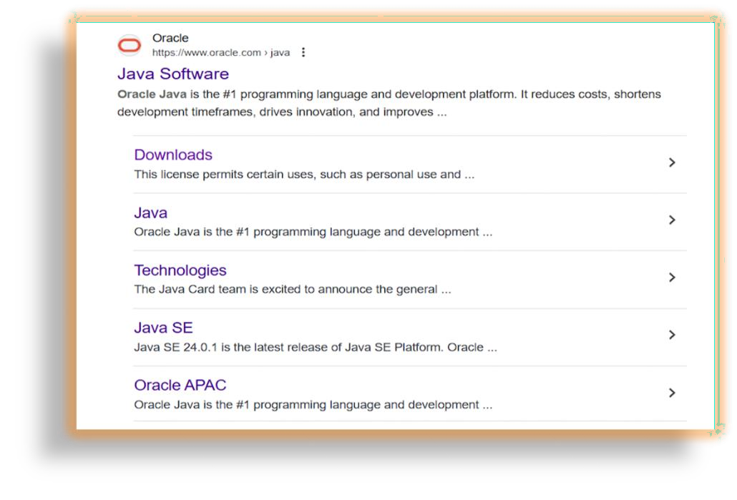
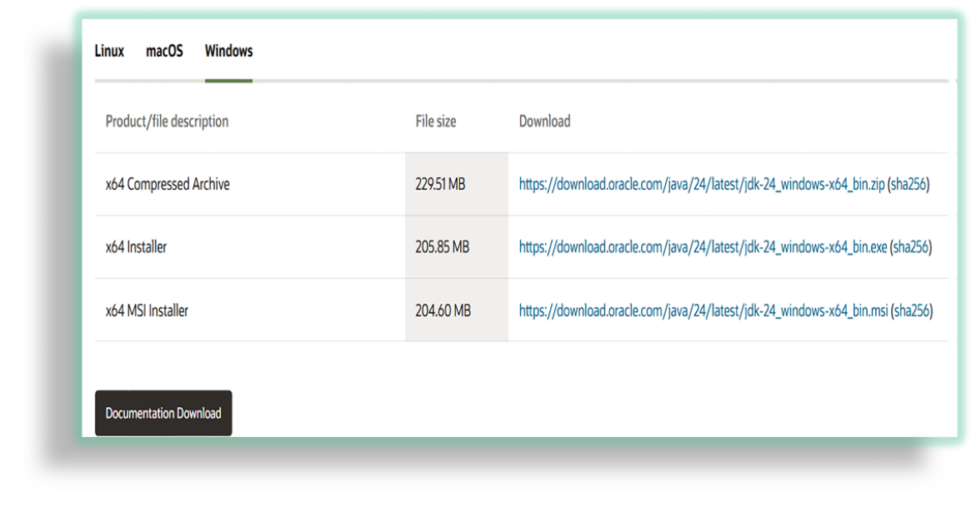
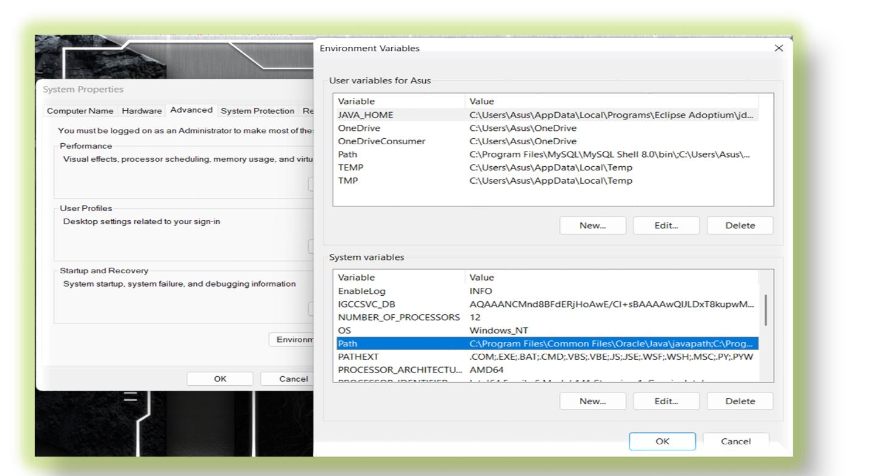

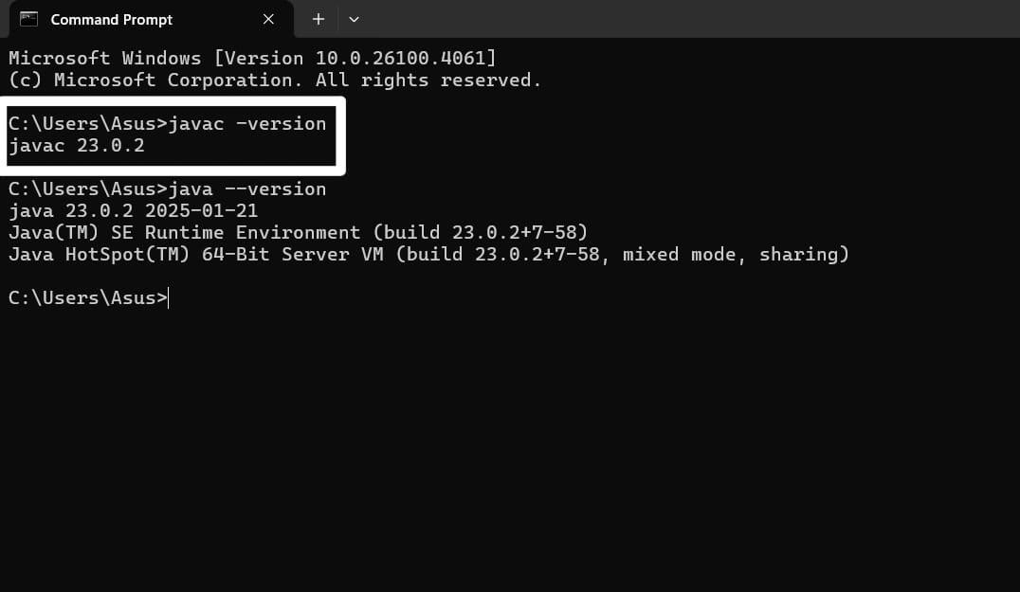
INSTALL JDK

Slide 6


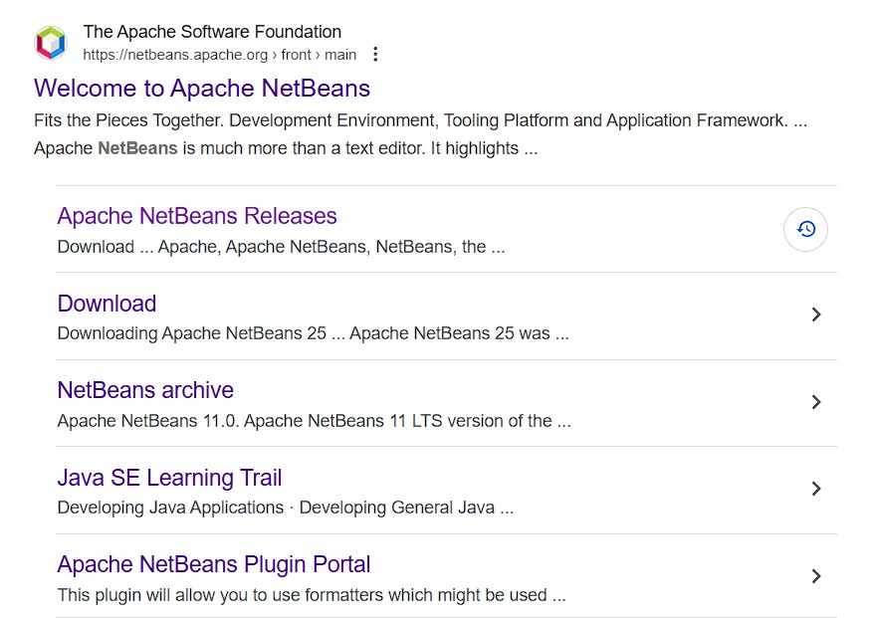
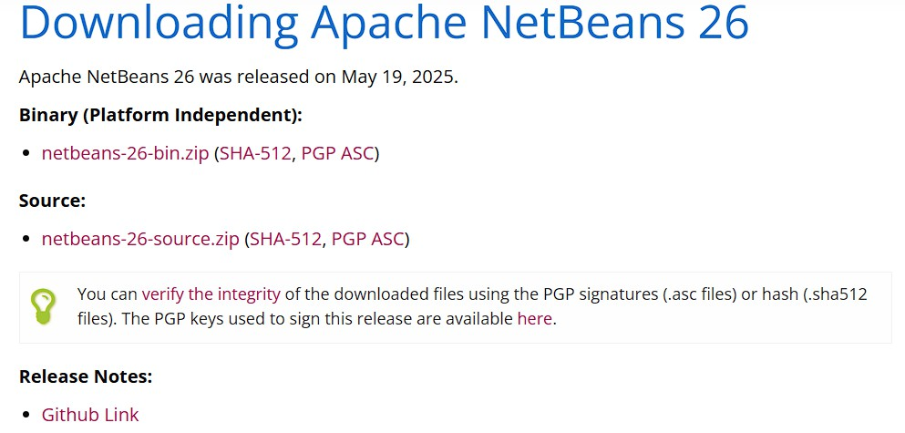

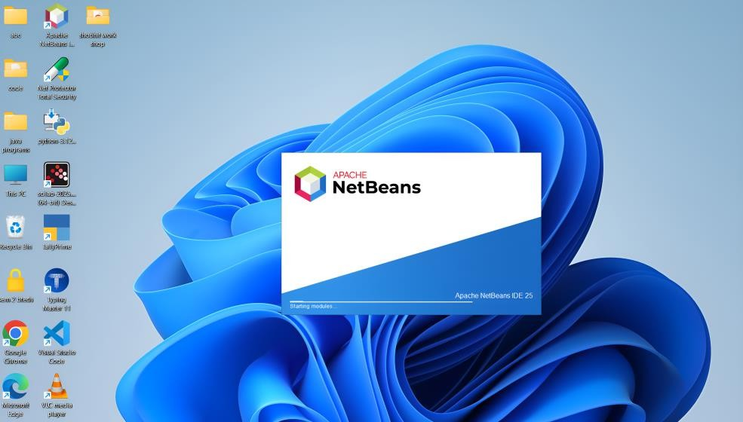
INSTALL IDE(NETBEANS)

Slide 7


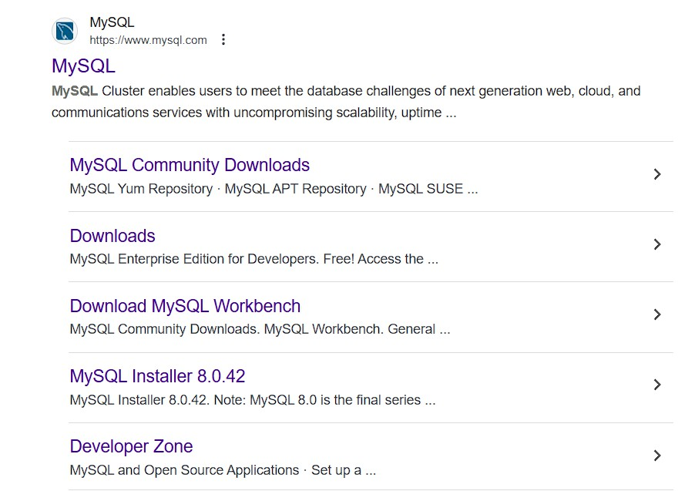
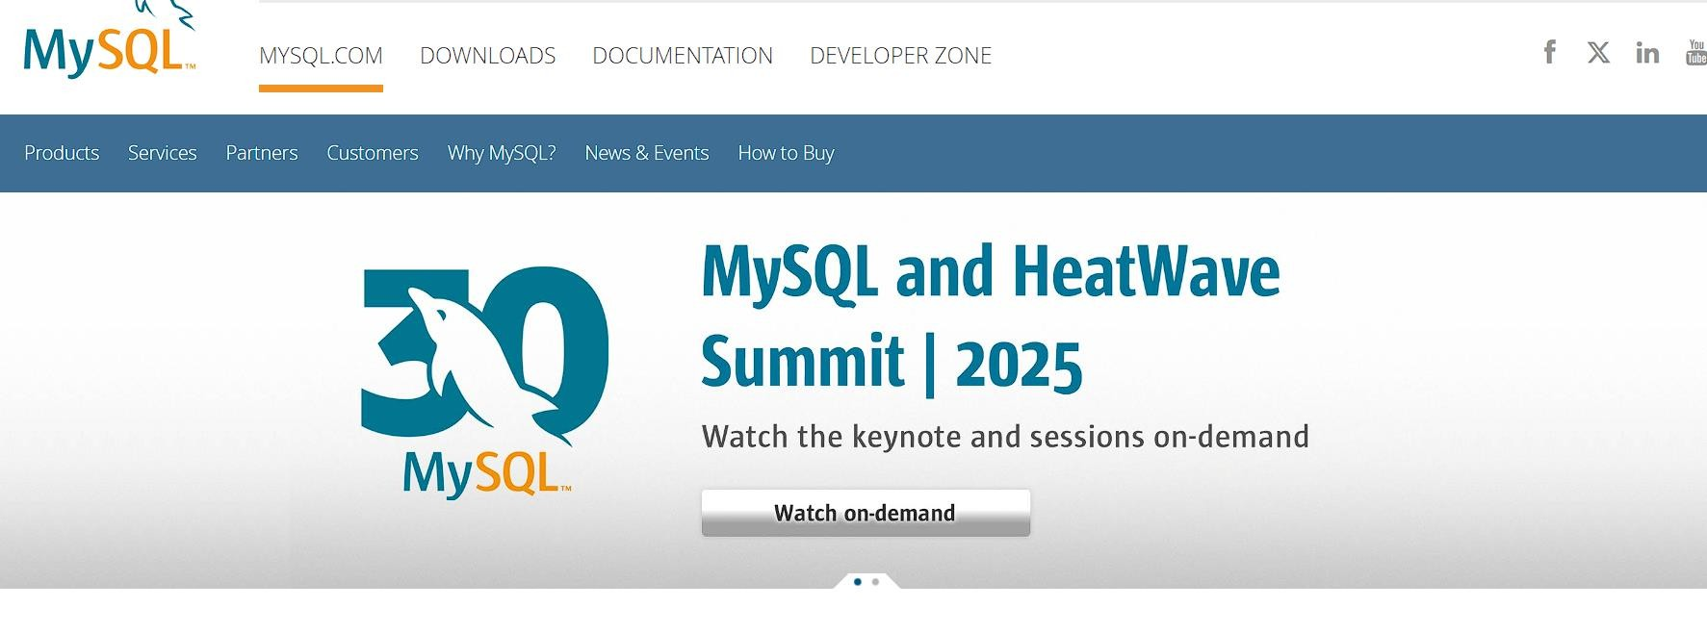

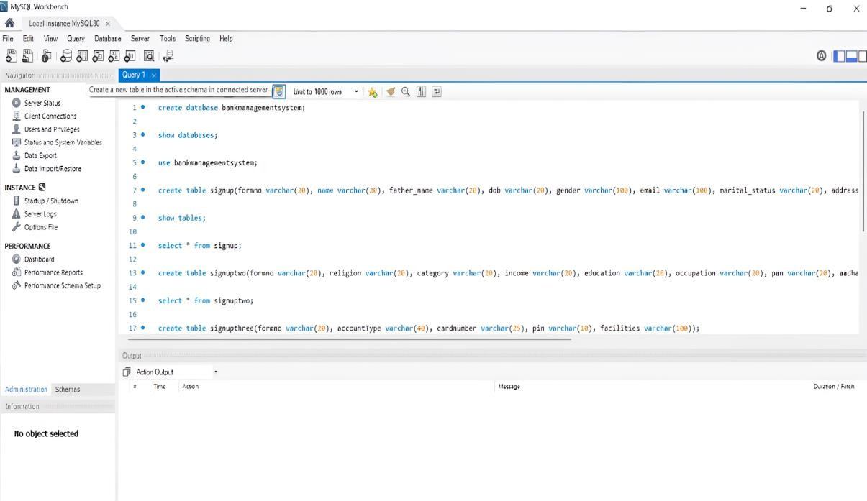
INSTALL MYSQL

Slide 8
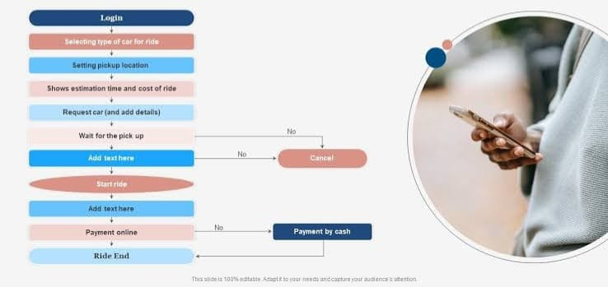
PROJECT STRUCTURE

Slide 9
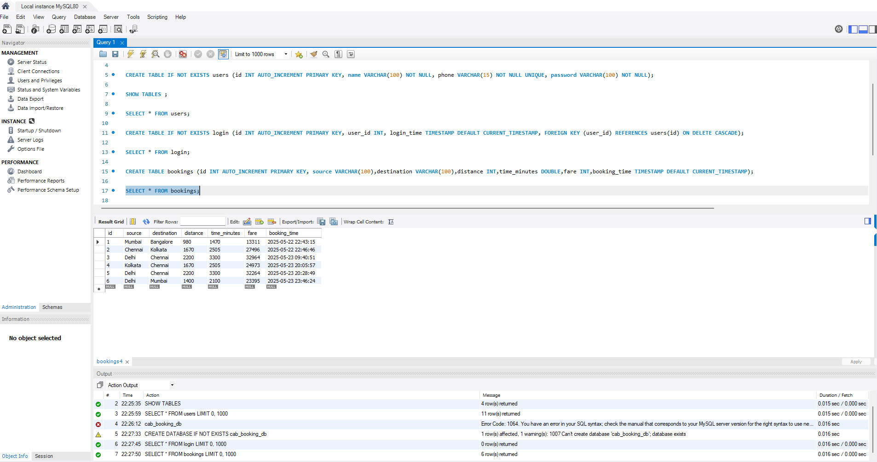
CREATE THE DATABASE STRUCTURE FOR THE PROJECT

Slide 10
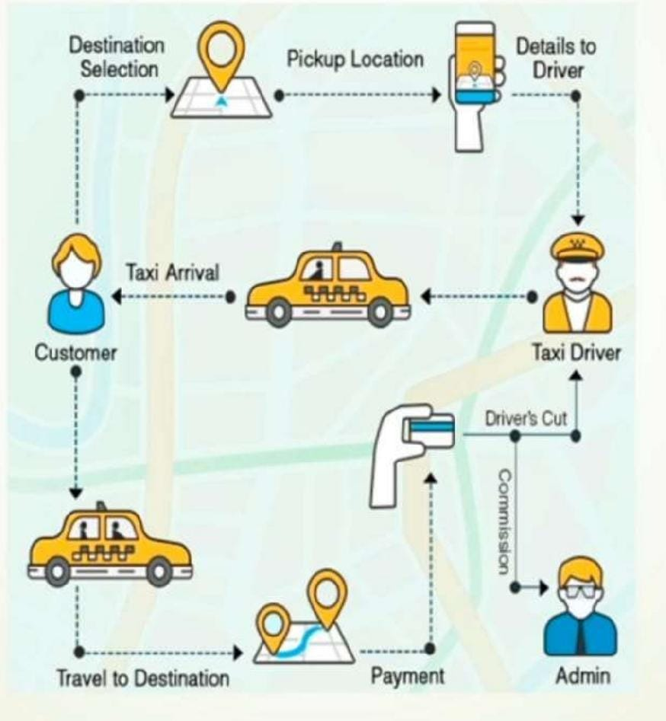
CURRENT FLOW OF CAB MANAGEMENT SYSTEM

Slide 11
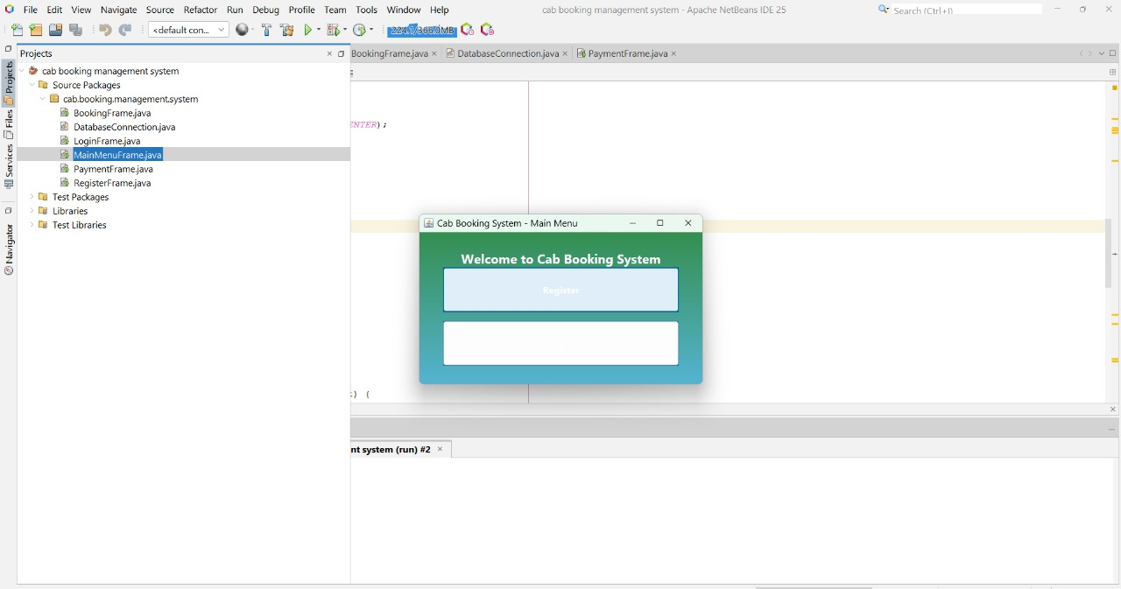

Slide 12
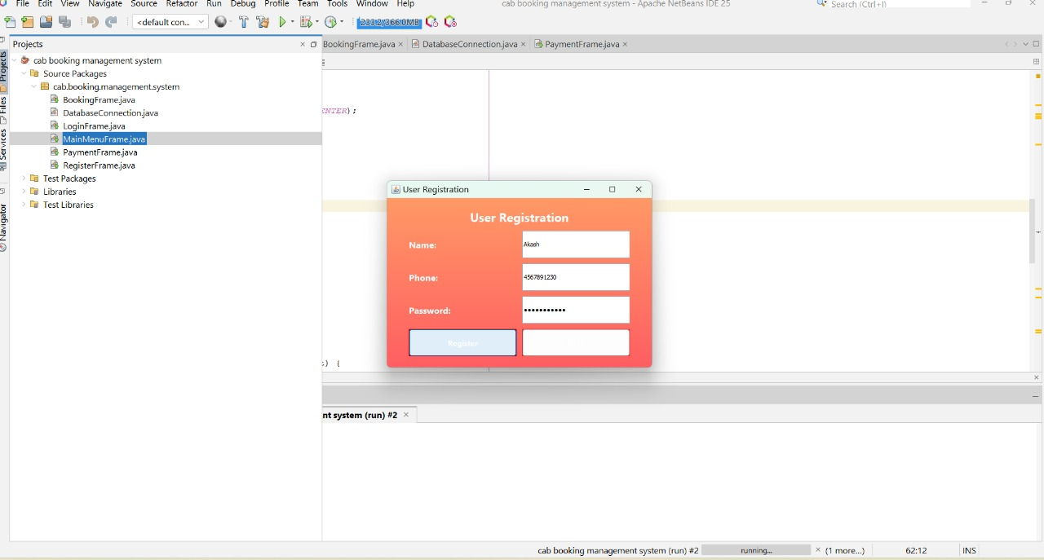

Slide 13
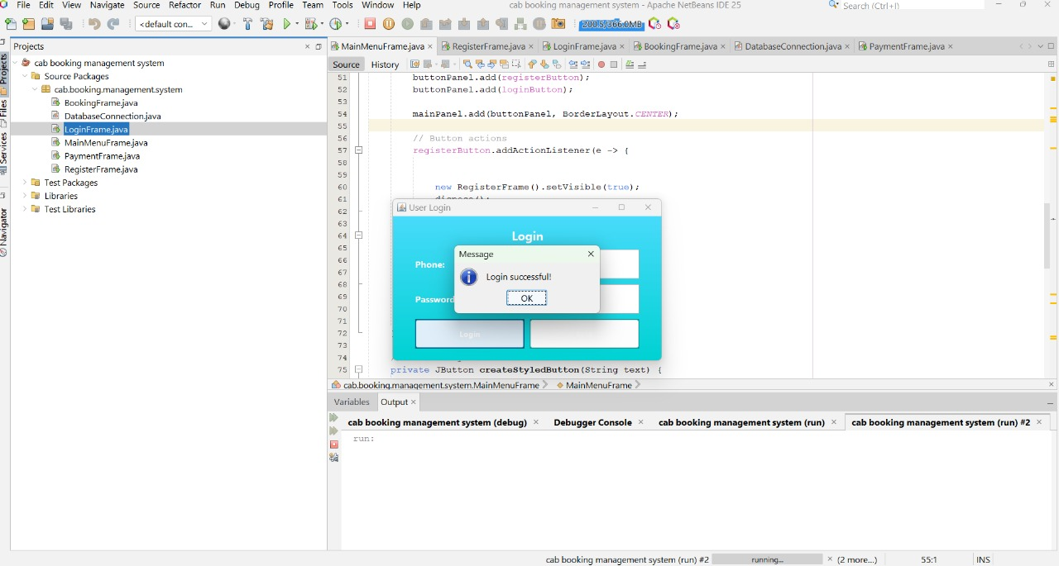

Slide 14
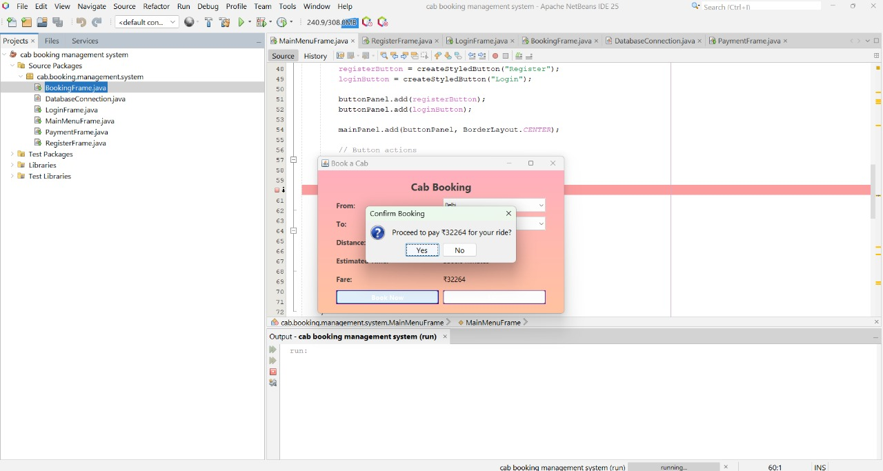

Slide 15
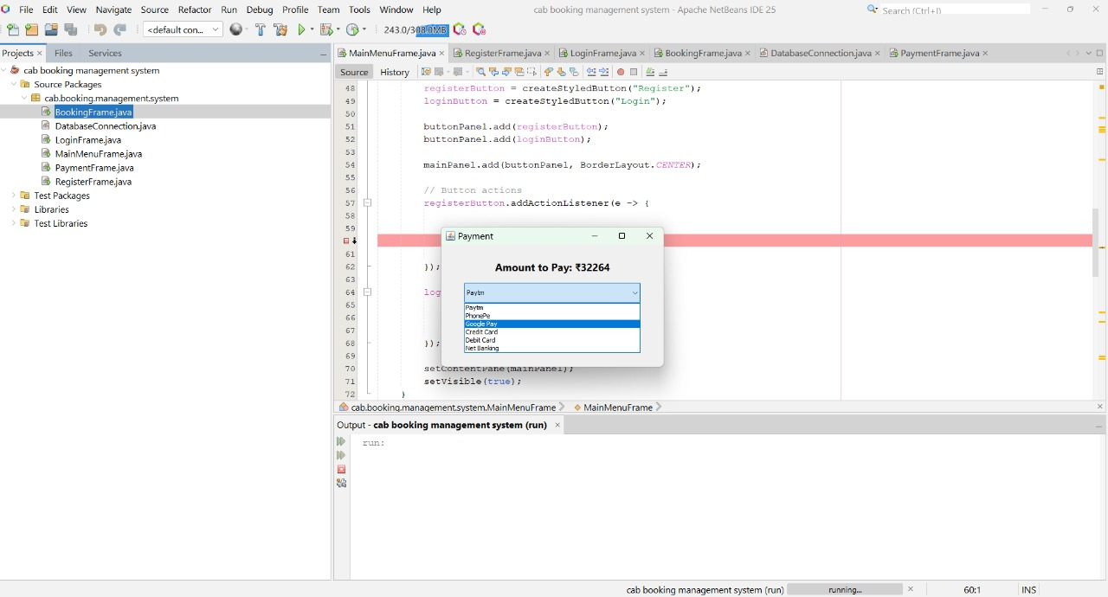

Slide 16
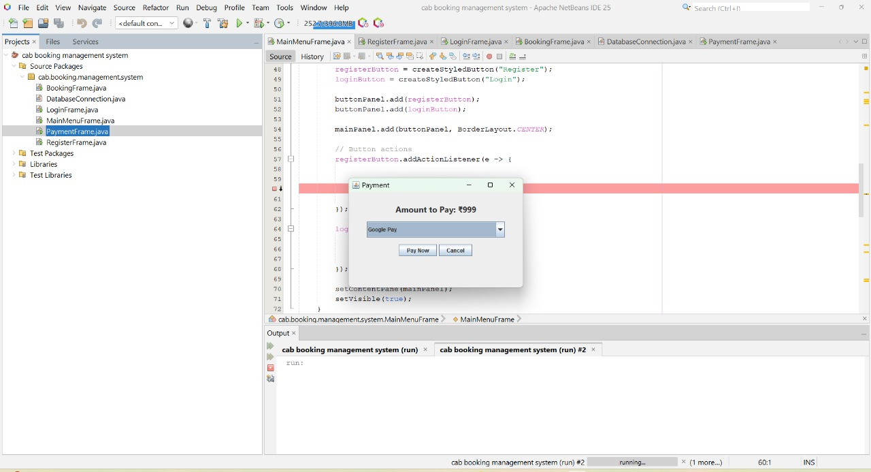

Slide 17
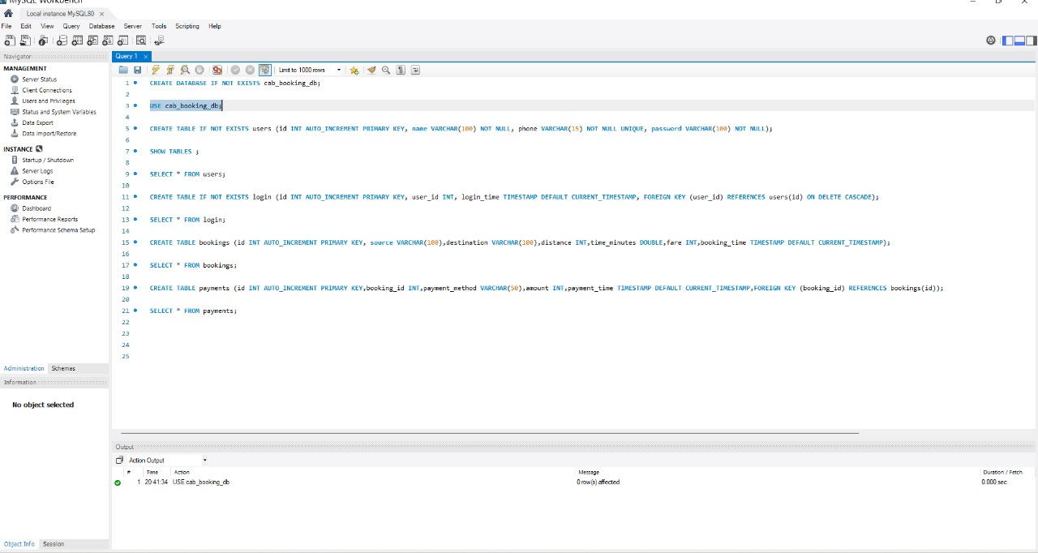

Slide 18
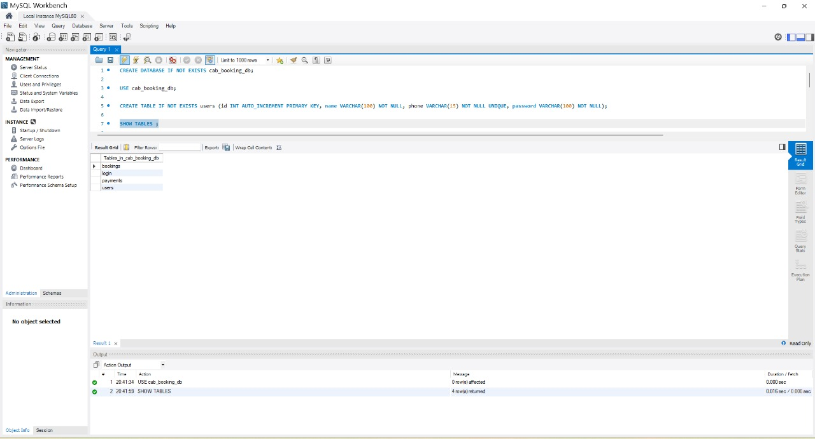

Slide 19
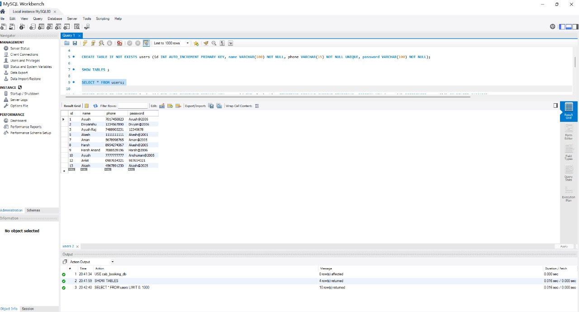

Slide 20
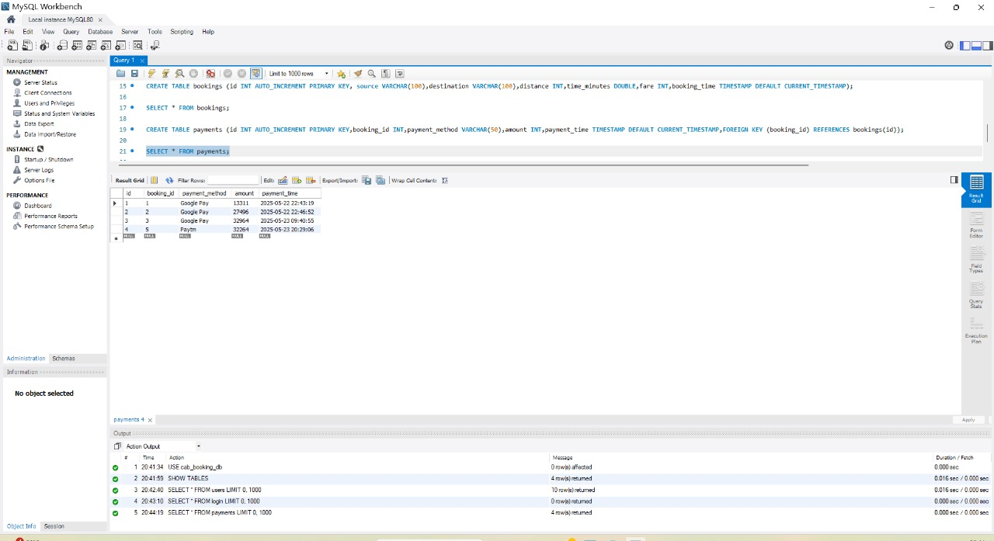

Slide 21

Responsiveness and Accessibility
Resizable Windows
GUI components adjust automatically when the window is resized for better visibility.
Keyboard Navigation
Users can navigate using Tab, Enter, and arrow keys for faster input without mouse.
Clear Fonts and Labels
Readable font size and proper label placement enhance user clarity and accessibility.
Error Messages & Dialogs
Prompt pop-up messages help users quickly correct input mistakes.
Consistent Layout
Uniform component alignment across all frames ensures a smooth user experience.

Slide 23
CAB MANAGEMENT SYSTEM
REVIEW-2

Slide 24
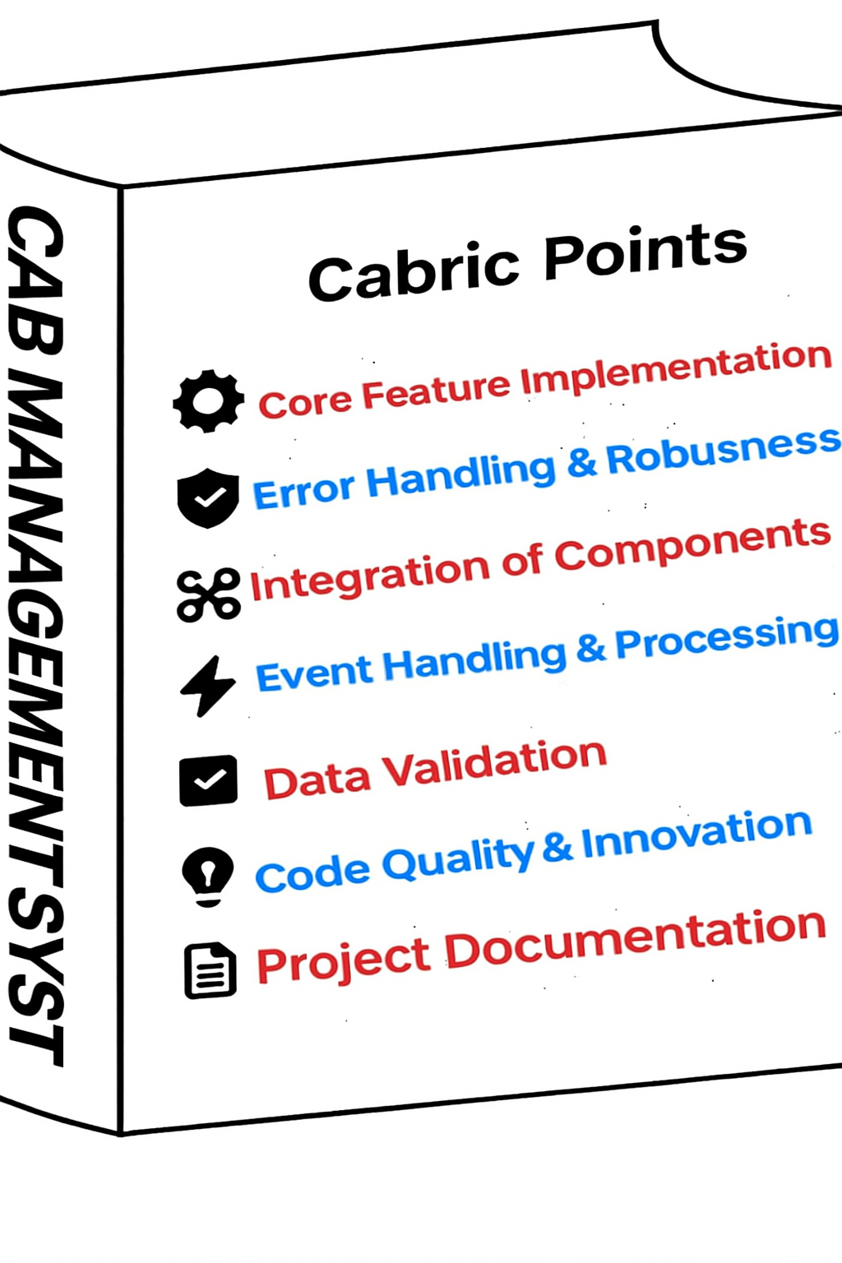

Slide 25
Rubric Points
✨Core Feature Implementation : Evaluation of how well essential functionalities are developed and meet requirements.
🛡️Error Handling & Robustness : Assessment of the system's ability to gracefully handle errors and maintain stability.
🔗Integration of Components : Review of seamless interaction and data flow between different modules.
⚡Event Handling & Processing : Analysis of the efficiency and accuracy in managing system events and user interactions.
✅Data Validation : Examination of mechanisms ensuring data integrity and correctness at all input points.
🚀Code Quality & Innovation : Evaluation of code readability, maintainability, and incorporation of novel solutions.
📄Project Documentation : Review of the completeness, clarity, and usefulness of all project-related documents.

Slide 26

Core Feature Implementation
Content:
  User registration & login flow
  Booking workflow (select cab, date/time)
  Payment confirmation
Visuals:
  Flowchart outlining each step
  Screenshots of each main frame

Slide 27
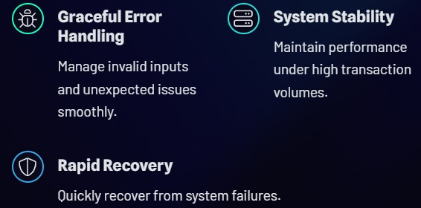
Error Handling & Robustness
🔹 Proper error handling is implemented using try-catch blocks to prevent application crashes and display user-friendly messages.
🔹 Critical failures like database issues are caught gracefully to ensure robustness.

Slide 28
Integration of Components
Content:
How GUI, Model, DAO, and DB connect end-to-end
Demonstration of a full booking transaction
Visuals:
End-to-end sequence diagram
Live demo screen-recording (embed small video)

Slide 29
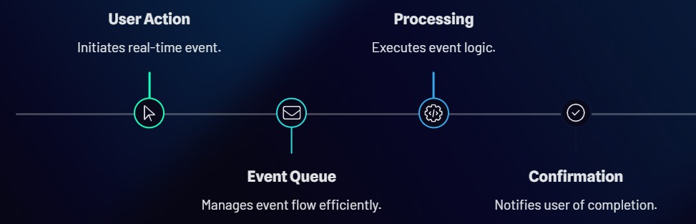
Event Handling & Processing
Content:
  ActionListeners for buttons
  Input validation triggered on events
Visuals:
  Code snippet of actionPerformed()
  Highlighted event-flow chart

Slide 30

Data Validation
Content:
Checks for empty fields, date/time validity, numeric ranges
Feedback to user (e.g., red border, error dialog)
Visuals:
Table listing validations vs. fields
Screenshot showing invalid-input warning

Slide 31
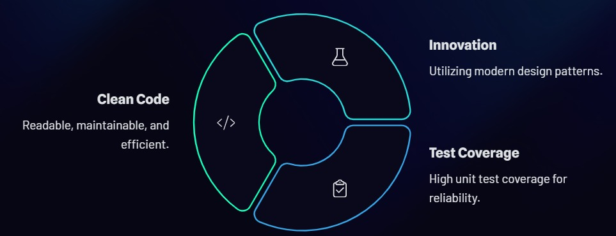
Code Quality & Innovation
Content:
Naming conventions, modular methods, comments
Any extra features (e.g., search history, filters)
Visuals:
Snippet illustrating well-structured code
Icon or badge highlighting an “innovation”

Slide 32
Design & Delivery Tips
Consistent Theme: Pick a 2-color palette + 1 accent; use the same fonts throughout (e.g., Calibri or Roboto).
High-Quality Images: Export your UI screenshots at 1920×1080 and crop tightly.
Engagement:
Embed brief demo videos (5–10 sec).
Use simple animations (Fly In for bullets).
Clarity: Keep ≤ 6 bullets per slide; use large fonts (≥ 24 pt).
Icons & Diagrams: Leverage built-in PowerPoint icons or free sets (e.g., Material Icons).
Practice Transitions: Smooth “Morph” or “Fade” between sections to maintain flow.

Slide 33
Project Documentation
Content:
README structure: overview, setup, usage
Inline Javadoc for key classes
Visuals:
Sample README screenshot
Javadoc-generated HTML snippet

Slide 34


